Slide 1
Detractors Profiling
Oct 20th, 2017 Big Data & Advanced Analytics

Slide 2
Executive Summary
Business problem
Profile Detractors versus Promoters based on declared and observable features.
Target
CBU customers segmented as Mobile-Only, Prepaid, VF Convergent Customers and ONO HH.
Data sources
NPS: Brand-NPS surveys
CAR: Sociodemographic profile, usage, billing, products & services information
CEM: QoS of mobile network (voice & data)
COPS Interactions (Apr – Jul 2017)
Quality Tool: QoS of fixed network
Timeframe
Feb – Jul 2017 for all data sources except for Quality Tool (Jun 2017).
Key insights
CAR and CEM provide light clues on detractor modelling, although not conclusive → e.g. more commitment on voice lines is clearly associated with promoters and low usage of MyVF is associated with detractors.
How VF solves technical problems is one of the most significant keys which deserves further study → every problem that is not solved or escalated is significantly associated with detraction together with technical questions on the services.
We created a model for Detractor/Neutral/Promoter applied to ONO Household customers (around 830k) which drives a call to action on around 80k customers.

Slide 3
Introduction & Methodology
NPS
CAR
CEM
COPS Interactions
Quality Tool
Segments
NPS surveys
(6,215 surveys)
Socio-demographics, billing, usage, P&S
(250 – 390 vars.)
Mobile QoS KPI’s and detailed data usage
(700 vars.)
Billing issues, tech incidents, informative calls, pricing, escalations, tranfers, etc.
(200 vars.)
DSL and HFC QoS KPI’s
(300 vars.)
VF Prepaid
(? rows)
VF Prepaid
(? rows)
Prepaid
(1663 rows)
Mobile-only
(1485 rows)
VF Convergent
(1566 rows)
Ono Household
(1501 rows)
Feb-Jul 2017

Slide 4
Introduction & Methodology
NPS
CAR
CEM
COPS Interactions
Quality Tool
Segments
NPS surveys
(6,215 surveys)
Socio-demographics, billing, usage, P&S
(250 – 390 vars.)
Mobile QoS KPI’s and detailed data usage
(700 vars.)
Billing issues, tech incidents, informative calls, pricing, escalations, tranfers, etc.
DSL and HFC QoS KPI’s
VF Prepaid
(? rows)
VF Prepaid
(? rows)
Prepaid
(1663 rows)
Mobile-only
(1485 rows)
VF Convergent
(1566 rows)
Ono Household
(1501 rows)
Feb-Jul 2017

Slide 5
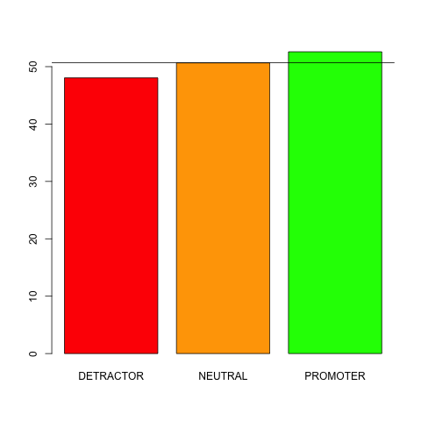
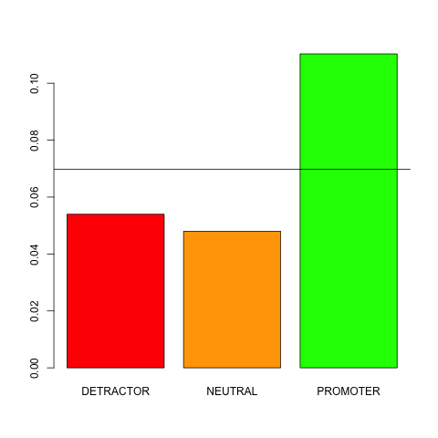
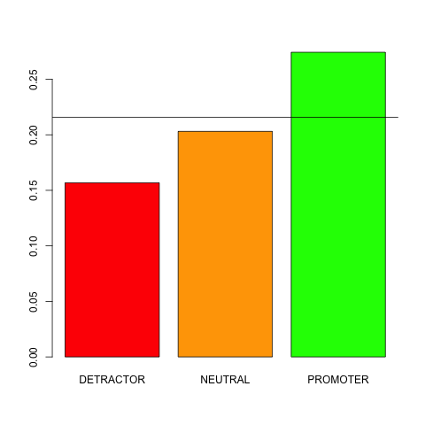
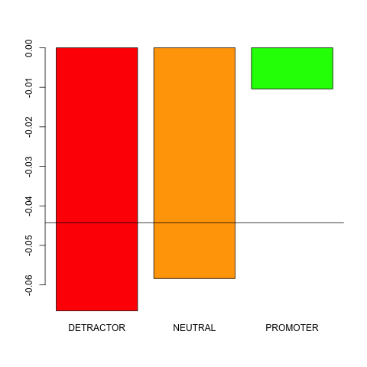
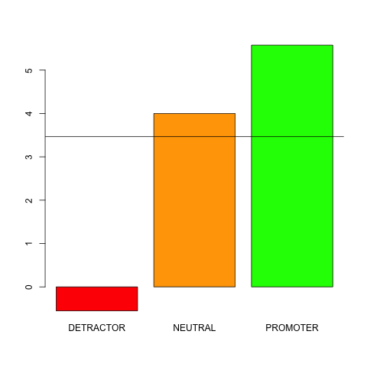
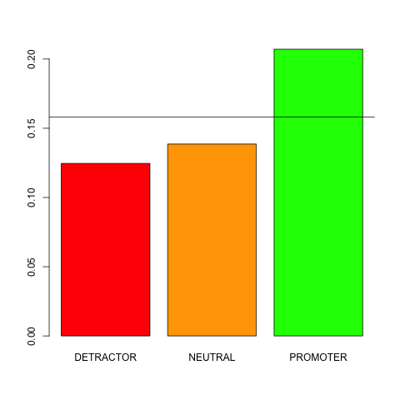
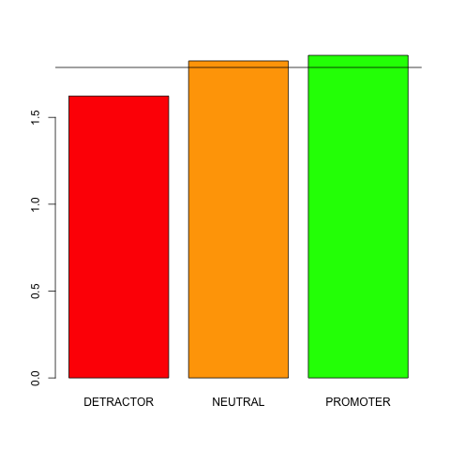
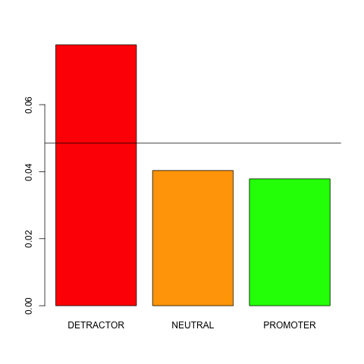
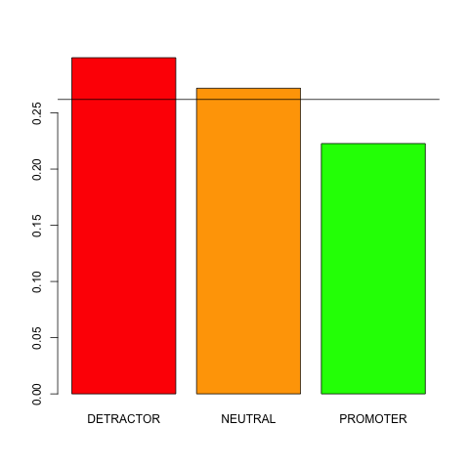
CAR – Mobile Only
CAR
Sociodemographics
Customer usage
Handsets
Age
No data usage on voice lines
No. non-mobile devices
Increment in tablet devices
Customer economics
Product & Services
Inferred
Commitment on voice lines
Homezone indicator
No. postpaid lines
Household ind.
Risk indicator
Insights
Commitment on detractors, on average, is over by 0.5 months, while promoters still have 5.5 months
Detractors without mobile data on voice lines is 50% less than promoters
Detractors have 43 % less of non-mobile devices than promoters

Slide 6
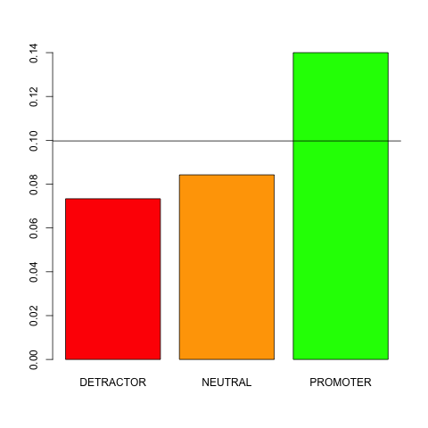
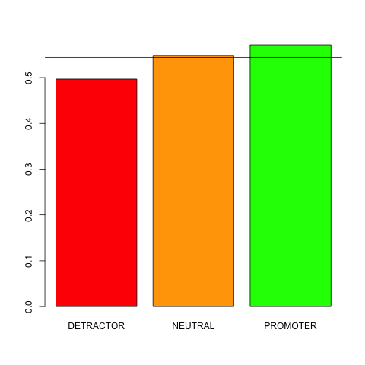
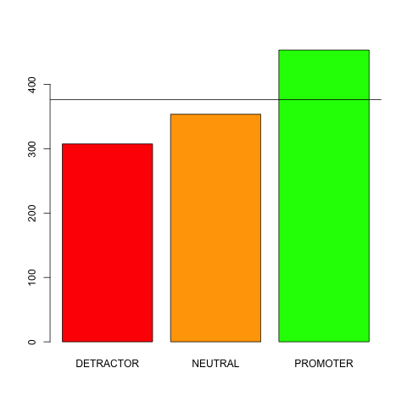
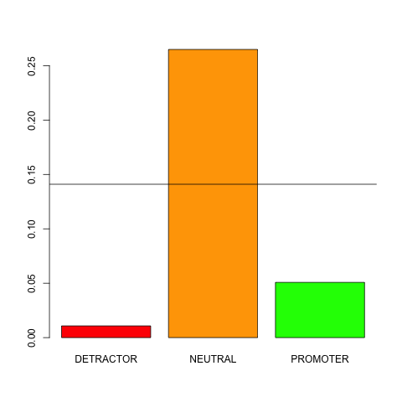
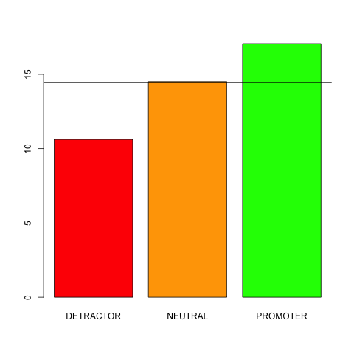
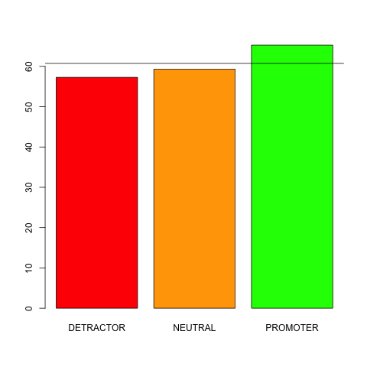
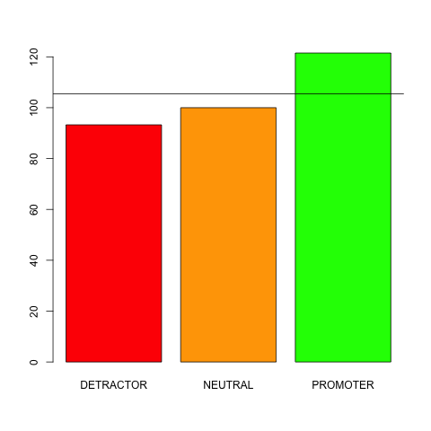
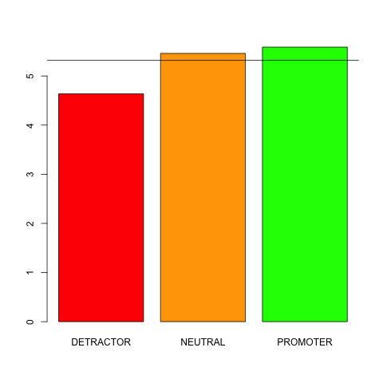
CAR – VF Convergent
CAR
Sociodemographics
Handsets
Customer usage
No. foreign clients in HH
Use of MyVodafone
Funded terminal price
Increment in mobile devices
Customer economics
Product & Services
No. pending payments
ARPU
Household ARPU
Increment in no. mobile devices
Tenure of oldest line
Insights
Detractors have 37% less pending payments, and terminals 32% cheaper
Detractors have 12% less ARPU than promoters

Slide 7
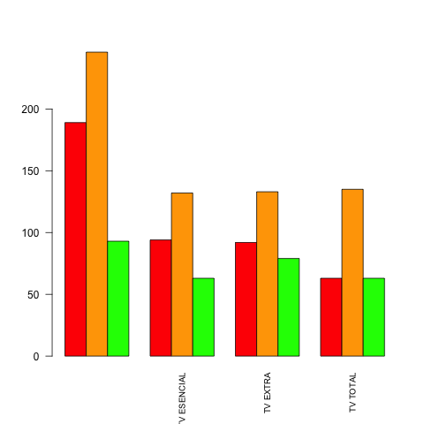
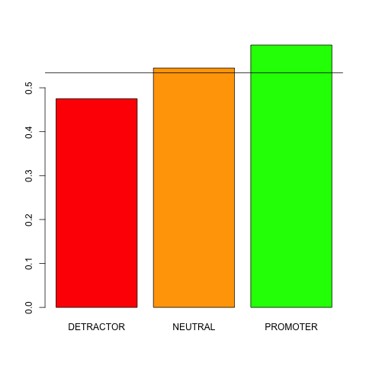
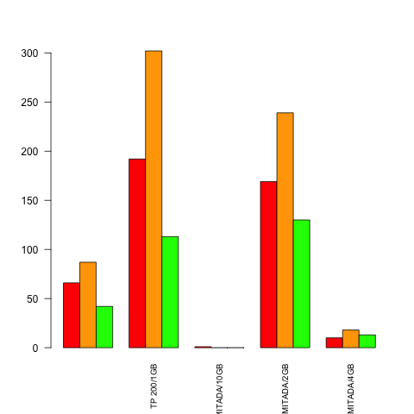
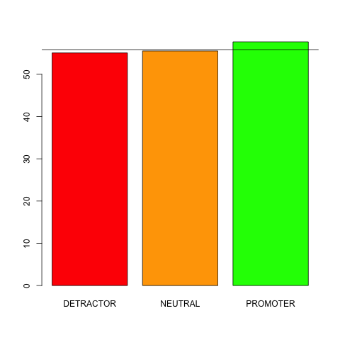
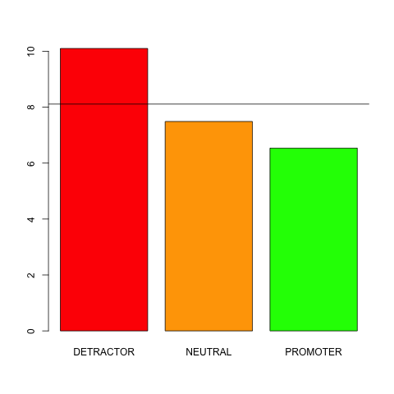
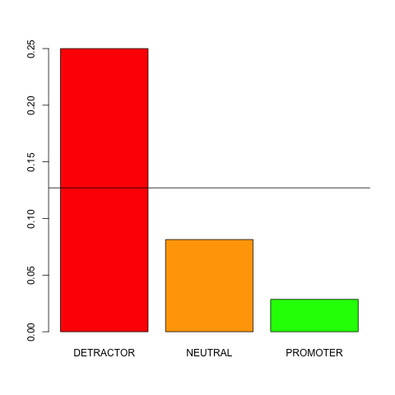
CAR – ONO Household
CAR
Product & Services
Use of TV
Use of Tivo
Data plans in mobile tariffs
Customer economics
Interactions
Combined ARPU
Months until end of promo
Doubt interactions
Insights
Detractors make less use of TV than promoters (detractors decrease from 36% no TV → 24% TV Total vs increase 18% → 24% in promoters). Also, clients with higher data plans in mobile has less detraction (32% with 1Gb → 24% with 4 GB)
Detractors have 7.1% less ARPU than promoters, on average
Detractors make 8x interactions about doubts more than promoters
Also, there are many ARPU and doubts related metrics found as relevant

Slide 8
Introduction & Methodology
NPS
CAR
CEM
COPS Interactions
Quality Tool
Segments
NPS surveys
(6,215 surveys)
Socio-demographics, billing, usage, P&S
(250 – 390 vars.)
Mobile QoS KPI’s and detailed data usage
(700 vars.)
Billing issues, tech incidents, informative calls, pricing, escalations, tranfers, etc.
DSL and HFC QoS KPI’s
VF Prepaid
(? rows)
VF Prepaid
(? rows)
Prepaid
(1663 rows)
Mobile-only
(1485 rows)
VF Convergent
(1566 rows)
Ono Household
(1501 rows)
Feb-Jul 2017

Slide 9
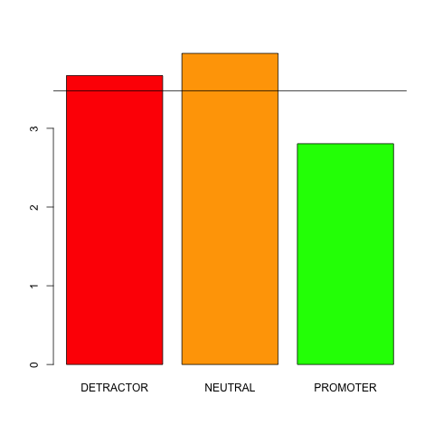
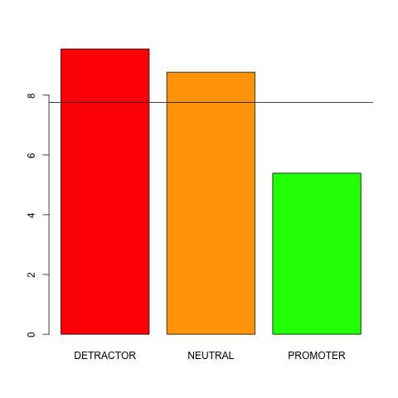
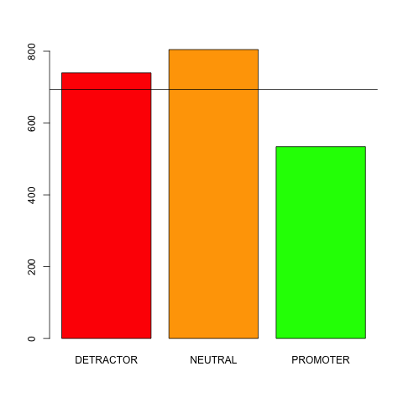
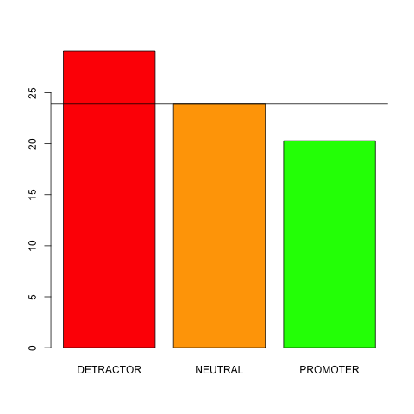
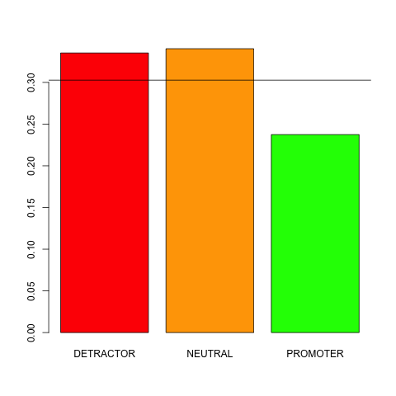
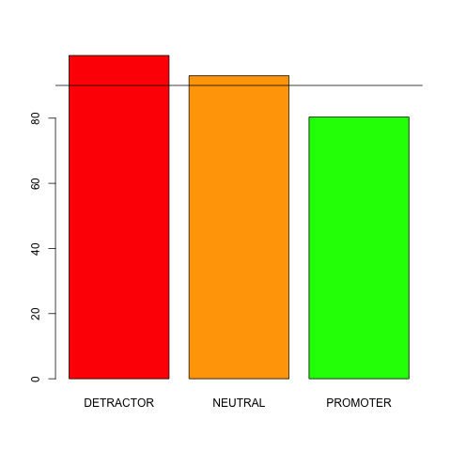
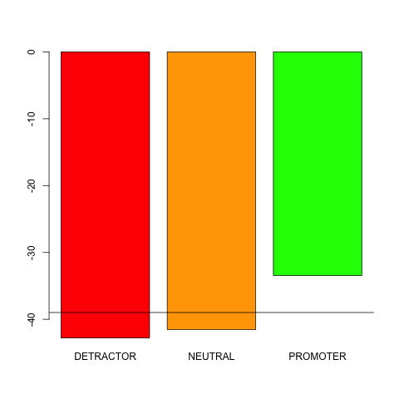
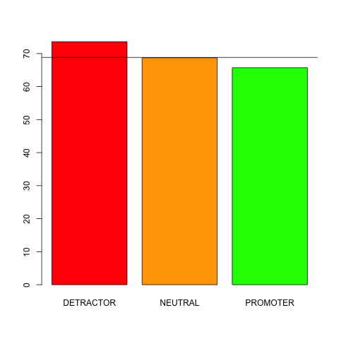
Mobile QoS KPI’s (CEM) – Mobile-Only
CEM
-
Mobile QoS
Avg. web page load time
Minimum use of email in month
Weight of Web SLI
Maximum use of email in month
Avg. web pages successfully loaded
Instant messaging use
Social networking use
Avg. uplink interference
Insights
Detractors experience 30 % higher load times of web pages than promoters
But, detractors experience 40% better web pages success rate than promoters
Minimum use of email in a month is 77% higher in detractors, and maximum is 43% higher
Weight of Web is 38% higher in detractors. Use of IM is 23% higher in detractors. Use of social networks is 12% higher in detractors

Slide 10
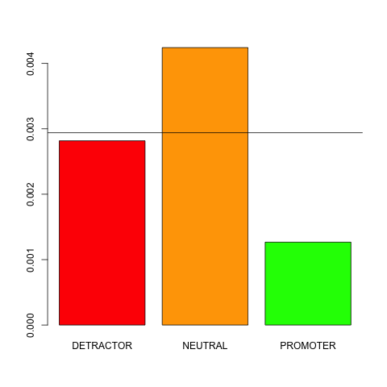
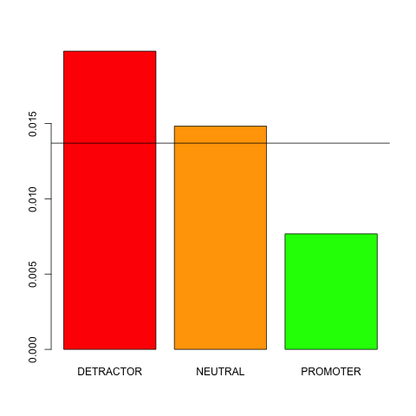

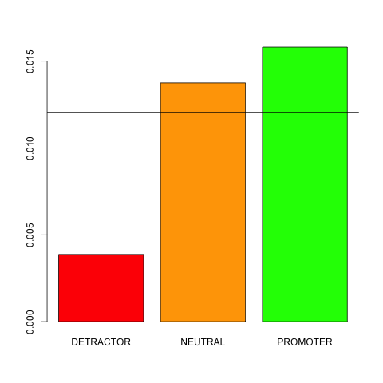
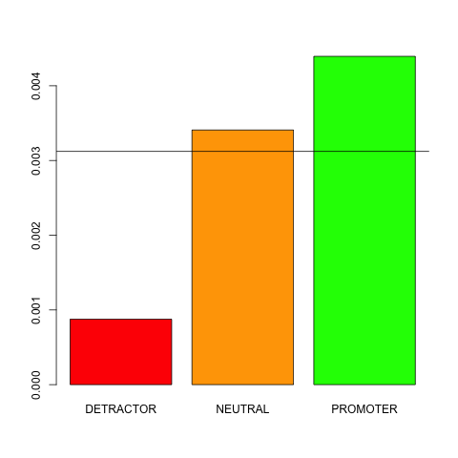
Mobile QoS KPI’s (CEM) – VF Convergent
CEM
-
Mobile QoS
Maximum call drop rate
Avg. call drop rate
Avg. call setup time
Avg. video rebuffering
Avg. video stall ratio
Insights
Detractors have 3x times avg. call drop rate, and 2x times max. call drop rate than promoters
Promoters have 60% more call setup time than detractors
Promoters have 3.75x times more video rebuffering, and 4x times more video stall ratio

Slide 11
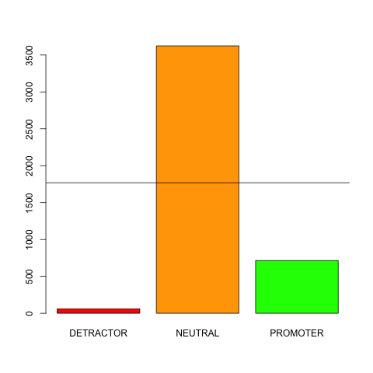
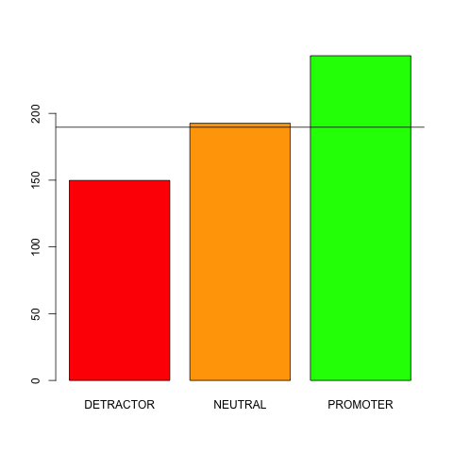

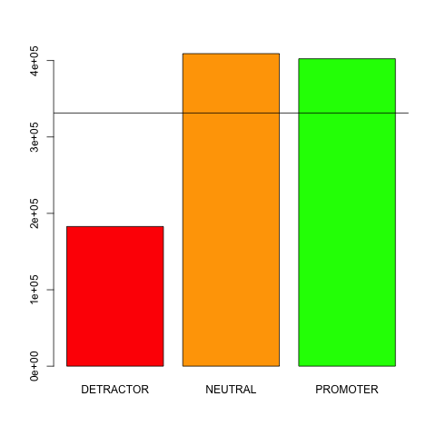
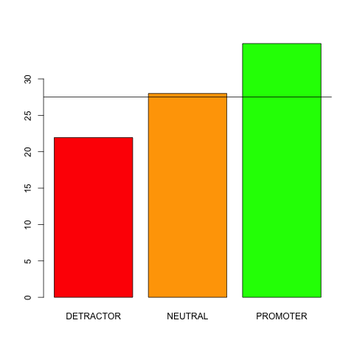
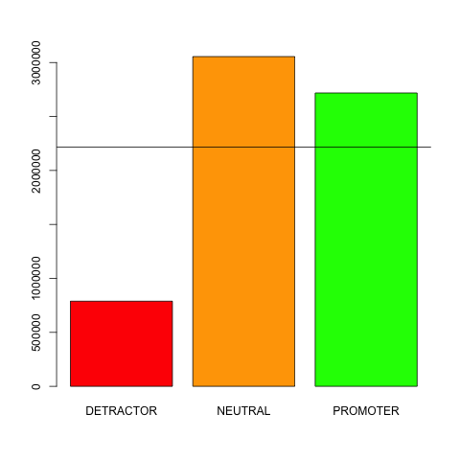
Mobile QoS KPI’s (CEM) – Ono Household
CEM
-
Mobile QoS
Minimum of bytes uploaded in 2G over month
Minimum of bytes downloaded in 2G over month
Minimum of data count
Minimum of bytes upload in 3G over month
Minimum of social networking count
Minimum of bytes downloaded in 3G over month
Insights
Minimum uploaded bytes in 2G over a month is 12x times more on promoters
Minimum downloaded bytes in 2G over a month is 9x times more on promoters
Minimum uploaded bytes in 3G over a month is 2.2x times more on promoters
Minimum downloaded bytes in 3G over a month is 3.4x times more on promoters

Slide 12
Introduction & Methodology
NPS
CAR
CEM
COPS Interactions
Quality Tool
Segments
NPS surveys
(6,215 surveys)
Socio-demographics, billing, usage, P&S
(250 – 390 vars.)
Mobile QoS KPI’s and detailed data usage
(700 vars.)
Billing issues, tech incidents, informative calls, pricing, escalations, tranfers, etc.
DSL and HFC QoS KPI’s
VF Prepaid
(? rows)
VF Prepaid
(? rows)
Prepaid
(1663 rows)
Mobile-only
(1485 rows)
VF Convergent
(1566 rows)
Ono Household
(1501 rows)
Feb-Jul 2017

Slide 13
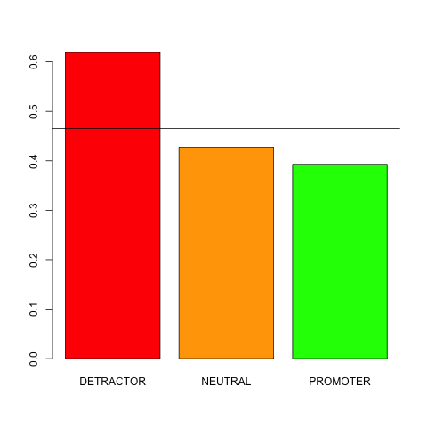
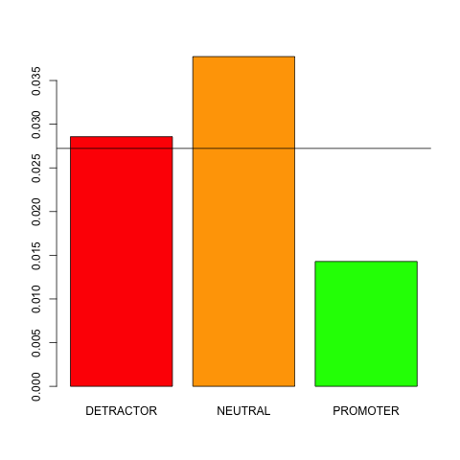
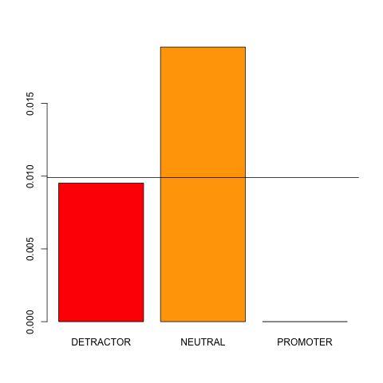
COPS Interactions – Mobile-Only
COPS Interactions
Billing
Mobile
Fiber
Insights
Detractors make 59% more interactions about billing than promoters
Detractors make 2x more interactions about Fiber incidences than promoters
Detractors make 3x times more interactions about mobile than promoters

Slide 14

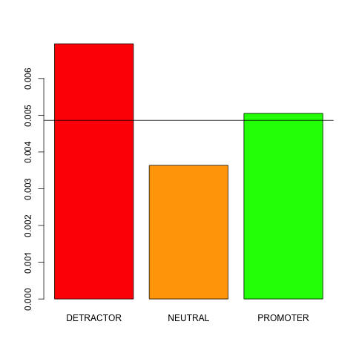
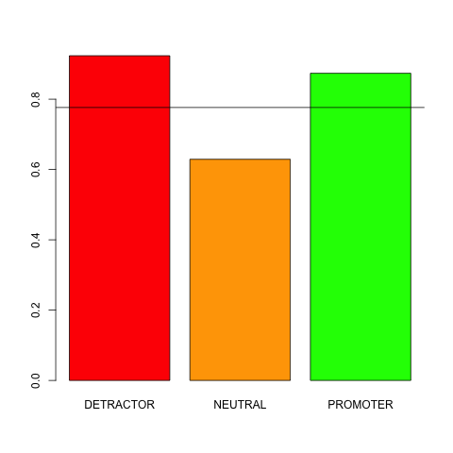
COPS Interactions – VF Convergent
COPS Interactions
DSL info request
Neba incidence
Information
Insights
Detractors make 67% more interactions requesting DSL information than promoters
Detractors make 40% more interactions about Neba incidences than promoters
Detractors make 5% more interactions requesting information than promoters

Slide 15
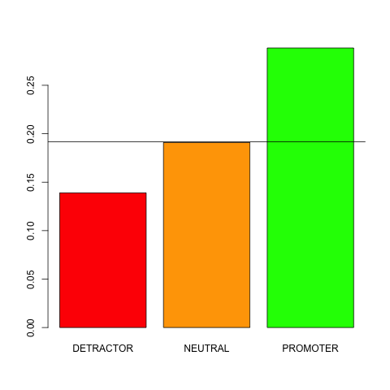
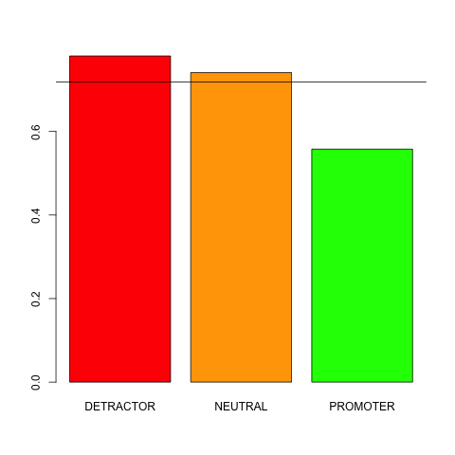
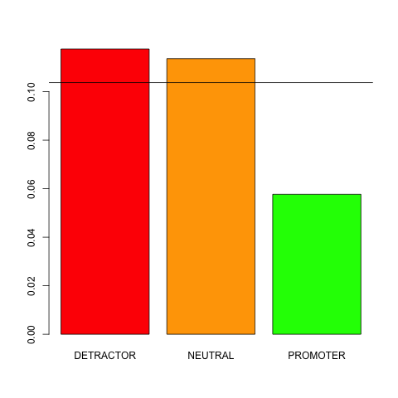
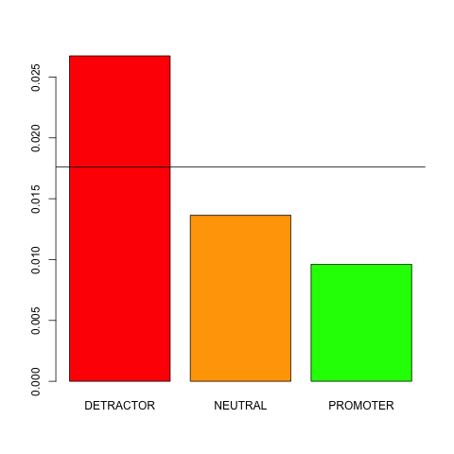
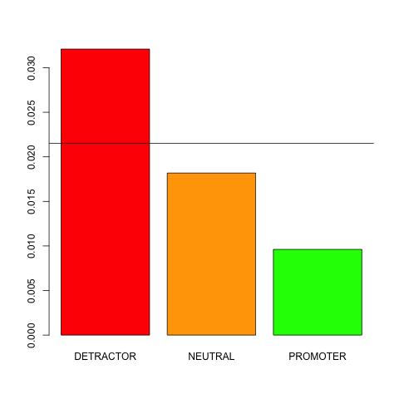
COPS Interactions – Ono Household
COPS Interactions
Billing
Buying
Churn
DSL incidence
Mobile incidence
Insights
Promoters make 2x times more interactions about buying than detractors
Detractors make 2x times more interactions about churn than promoters
Detractors make 40% more interactions about billing than promoters
Detractors make 3x times more interactions about mobile and DSL incidences than promoters

Slide 16
Introduction & Methodology
NPS
CAR
CEM
COPS Interactions
Quality Tool
Segments
NPS surveys
(6,215 surveys)
Socio-demographics, billing, usage, P&S
(250 – 390 vars.)
Mobile QoS KPI’s and detailed data usage
(700 vars.)
Billing issues, tech incidents, informative calls, pricing, escalations, tranfers, etc.
DSL and HFC QoS KPI’s
VF Prepaid
(? rows)
VF Prepaid
(? rows)
Prepaid
(1663 rows)
Mobile-only
(1485 rows)
VF Convergent
(1566 rows)
Ono Household
(1501 rows)
Feb-Jul 2017

Slide 17


Quality Tool – Ono Household
Quality Tool
Insights
Detractors have 41% less ADSL download rate than promoters
Detractors experience 4x more cuts than promoters

Slide 18
Next Steps
1
Data Sources
More features on billing, discounts, promos, etc.
Include NetPerform data and more data for Fixed QoS KPI’s
2
Further
Analyses
Root cause of detractions through specific surveys
Combine all data sources and build a classification model
3
Actions
Provide meaningful rules to launch CEX actions

Slide 19
Backup

Slide 20
Introduction & Methodology
NPS
CAR
(250 – 390 vars.)
CEM*
(700 vars.)
* CEM has been joined with
surveyed MSISDN’s only
Feb - Jul
2017
NPS
(6215 surveys)
Prepaid
(1663 rows)
VF Prepaid
(? rows)
VF Prepaid
(? rows)
Mobile-only
(1485 rows)
VF Postpaid
(1352 rows,
390 vars.)
Mobile-only
(764 rows,
1.1K vars.)
VF Convergent
(1566 rows)
VF Postpaid
(1429 rows,
390 vars.)
VF Convergent
(753 rows,
1.1K vars.)
Ono Household
(1501 rows)
Ono Household
(1382 rows,
280 vars)
Ono Household
(542 rows,
1K vars.)

Slide 21
Selection of most relevant variables
Permutation test
Student’s t
NPS
CAR
(250 – 390 vars.)
CEM*
(700 vars.)
NPS+CAR+CEM
(1K – 1.1K vars.)
Global Ranking
Mann-Whitney-Wilcoxon
Kruskal-Wallis

